Slide 1
CORPORATE WELLNESS TEAM ENGAGEMENT

Slide 2
Agenda
Problem Statement
Proposed Solution: Wellness Game
Game Design & Features
Technology Stack
Benefits & Impact
Future Scope & Innovation

Slide 3
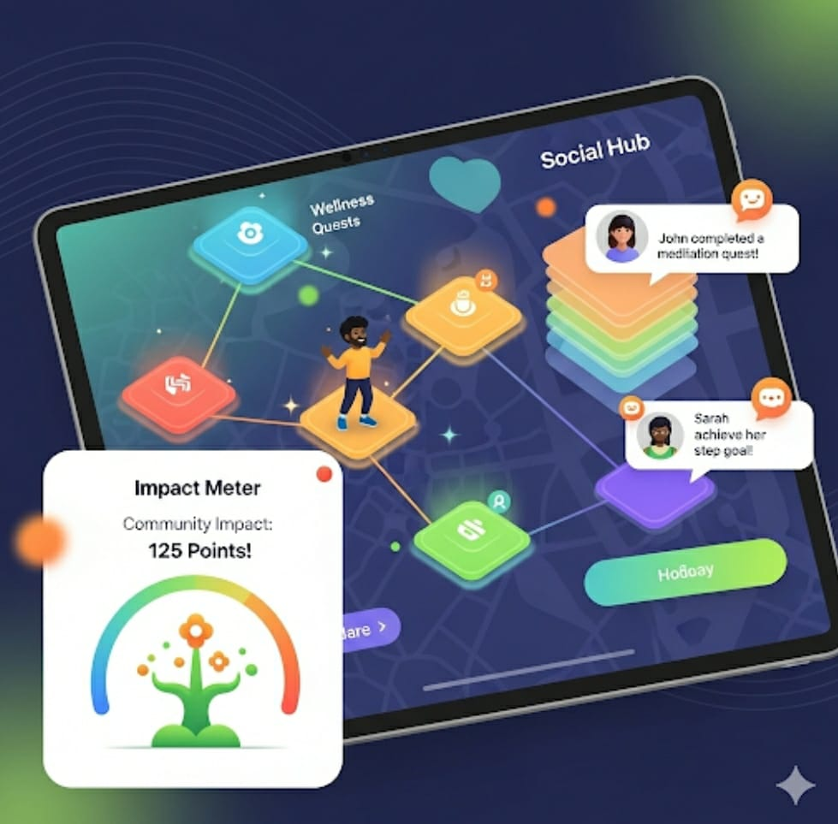
Problem Statement
Employees struggle to stay motivated in wellness programs. Traditional apps track health but don’t keep users engaged. Our challenge is: How can we make wellness fun, social, and impactful?.

Slide 4
Proposed Solution: Wellness Game Wellness World is a gamified wellness challenge designed for corporate offices. * Each team represents a village. * Steps walked help build houses 🏠. * Yoga or meditation minutes help plant trees 🌳. * Calories burned generate energy ⚡ for the village. * At the end of the challenge, the healthiest village wins 🏆.

Slide 5

Game Design & Feature
Steps → Houses: If all team members reach their step goal, new houses are added to their village.
Yoga & Meditation → Trees/Plants: Mental wellness adds greenery to the village.
Hydration → Water in Wells: Drinking enough water keeps the wells full; otherwise, the village shows a water shortage.
Calories Burned → Electricity + Coins: Calories convert into electricity and coins, which further convert into points.
Leaderboard → Village Rankings: Villages compete with each other based on points.
Health Status → Village Health: A healthy team = a thriving village; poor participation = problems like dry wells or lack of greenery.

Slide 6
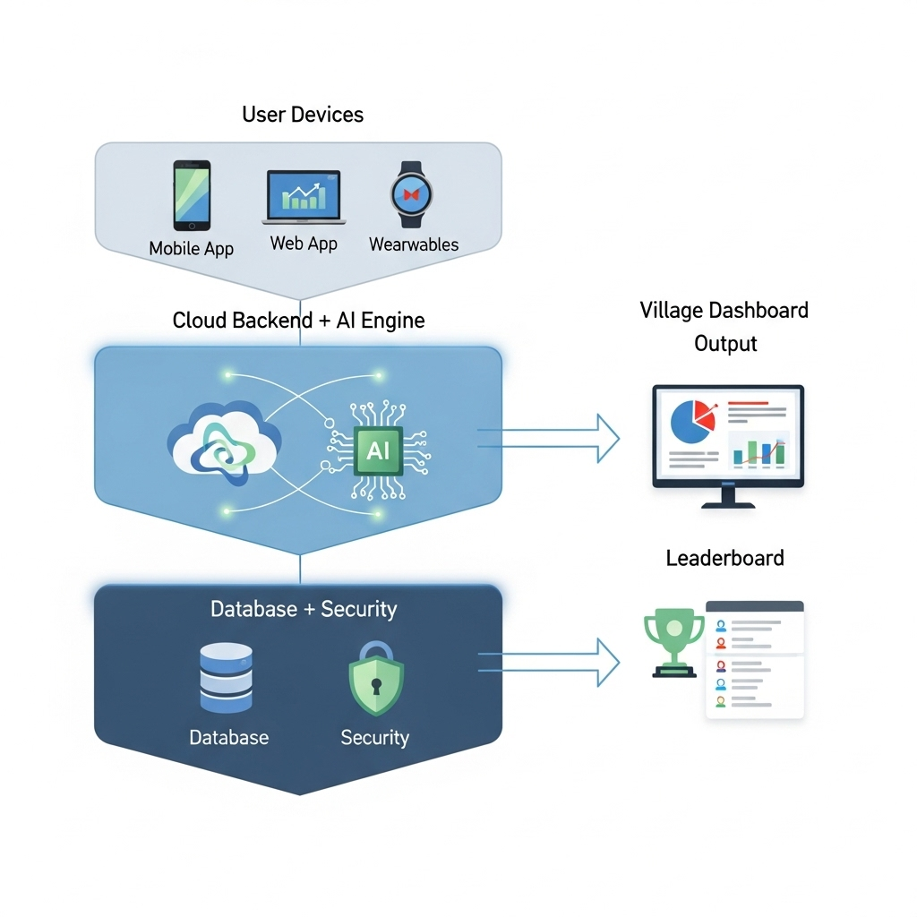
Technology stack
Frontend: Mobile/Web app (React Native)
Backend: Node.js
Database: Firebase.
Wearable Integration: Google Fit, Apple Health, Fitbit APIs.
AI Engine: Converts wellness data into game progress & challenges.
Security: OAuth 2.0 / JWT for secure login and data privacy.

Slide 7

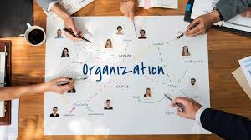
Impact:
Benefits:
Makes wellness fun & engaging 🎮
Encourages team collaboration 👥
Improves physical fitness & mental health 💪🧘
Builds a sense of achievement & motivation 🏆
Boosts employee productivity & morale 🚀
Reduces absenteeism & healthcare costs 💰
Creates a positive workplace culture 🌱
Strengthens employer branding 💼

Slide 8

Future scope & Innovation
In the future, companies can compete in global wellness tournaments, turning health into a culture-driven game."

Slide 9
Thank you

